Slide 1
Expense Tracker App
GROUP MEMBERS
MUHAMMAD AMAD(8602)
FURQAN AHMED(8297)

Slide 2
Expense Tracker App
Title: Expense Tracker App (React Native)
Content:
This is a mobile application used to record income and expenses and manage personal finances easily.

Slide 3
Project Overview
This app is made for academic purposes and shows how React Native works using:
Functional components
React Hooks
Navigation
Local storage
It helps users understand mobile app development basics.

Slide 4
Technologies Used
React Native – for mobile app development
Expo – for easy setup and testing
JavaScript – app logic
AsyncStorage – save data locally
React Navigation – move between screens

Slide 5
Main Features
The app allows users to:
Add income and expenses
Select categories
View monthly summary
See charts for better understanding
This makes money tracking simple and clear.

Slide 6
Add Income & Expense
Users can enter:
Amount
Description
Category
Type (Income or Expense)
The app checks for empty or negative values and saves data automatically.

Slide 7
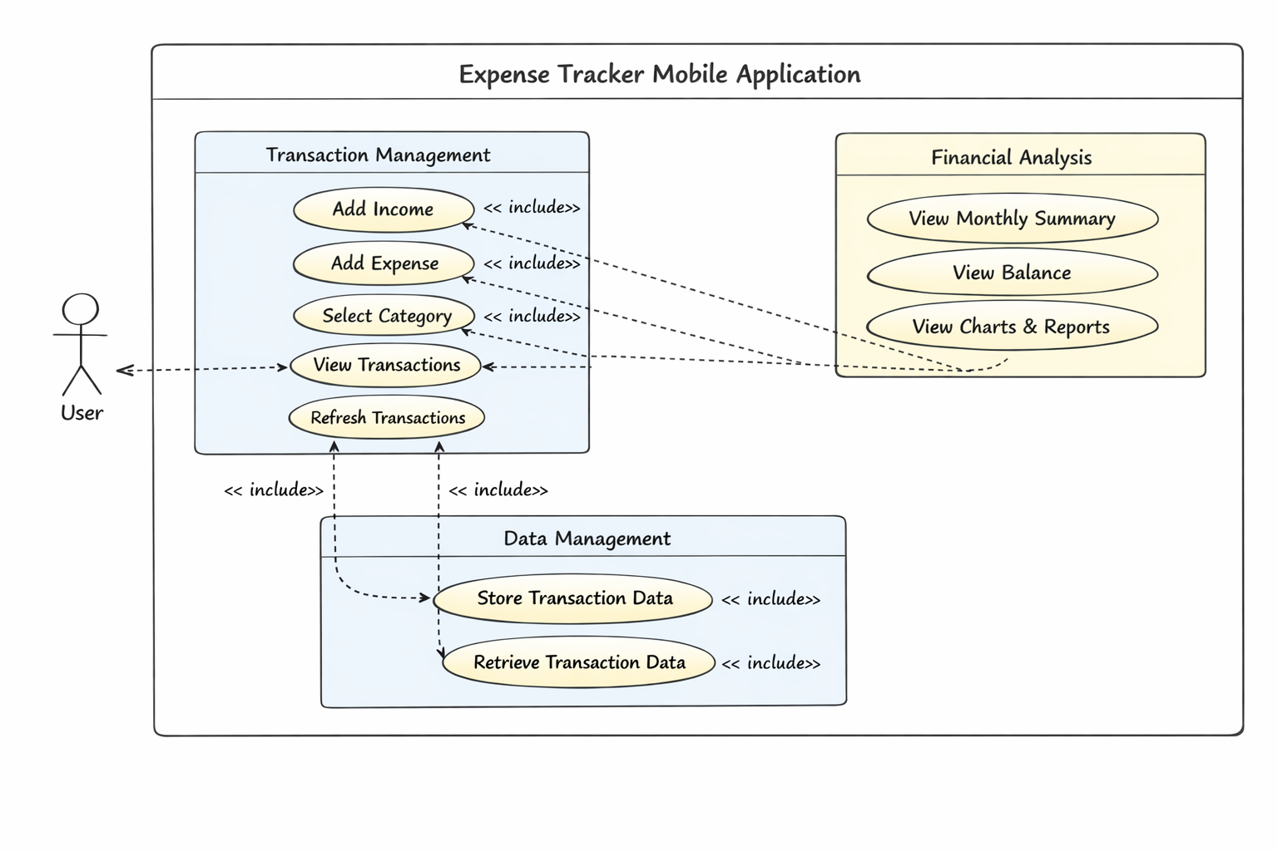
Use case diagram

Slide 8
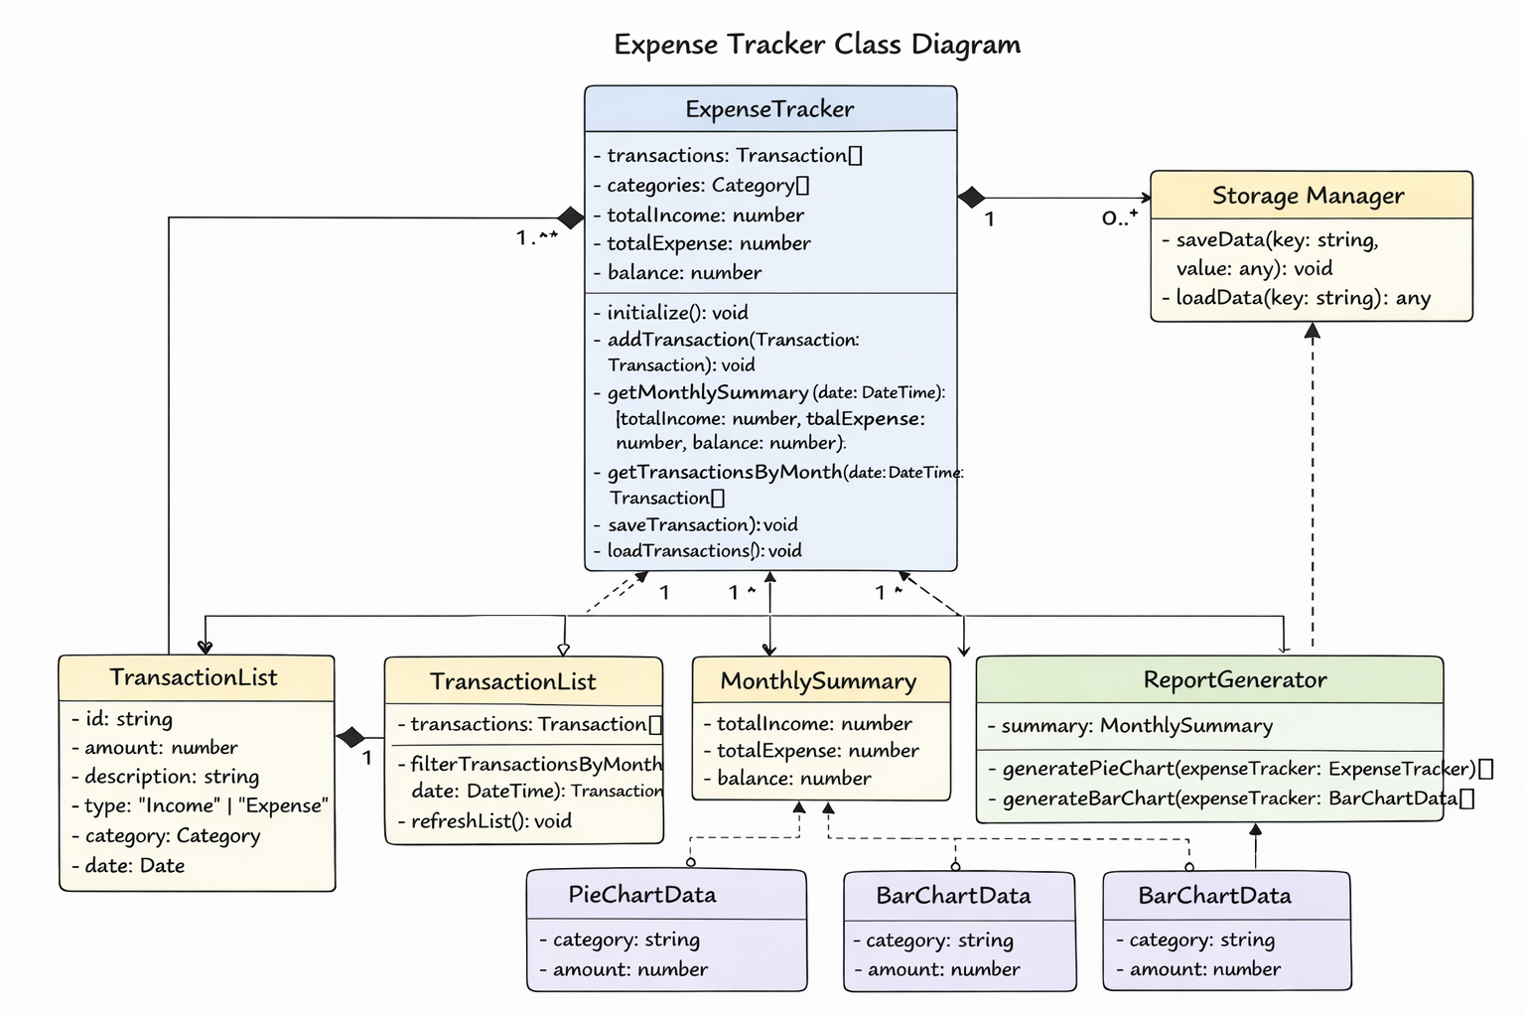
Class diagram

Slide 9
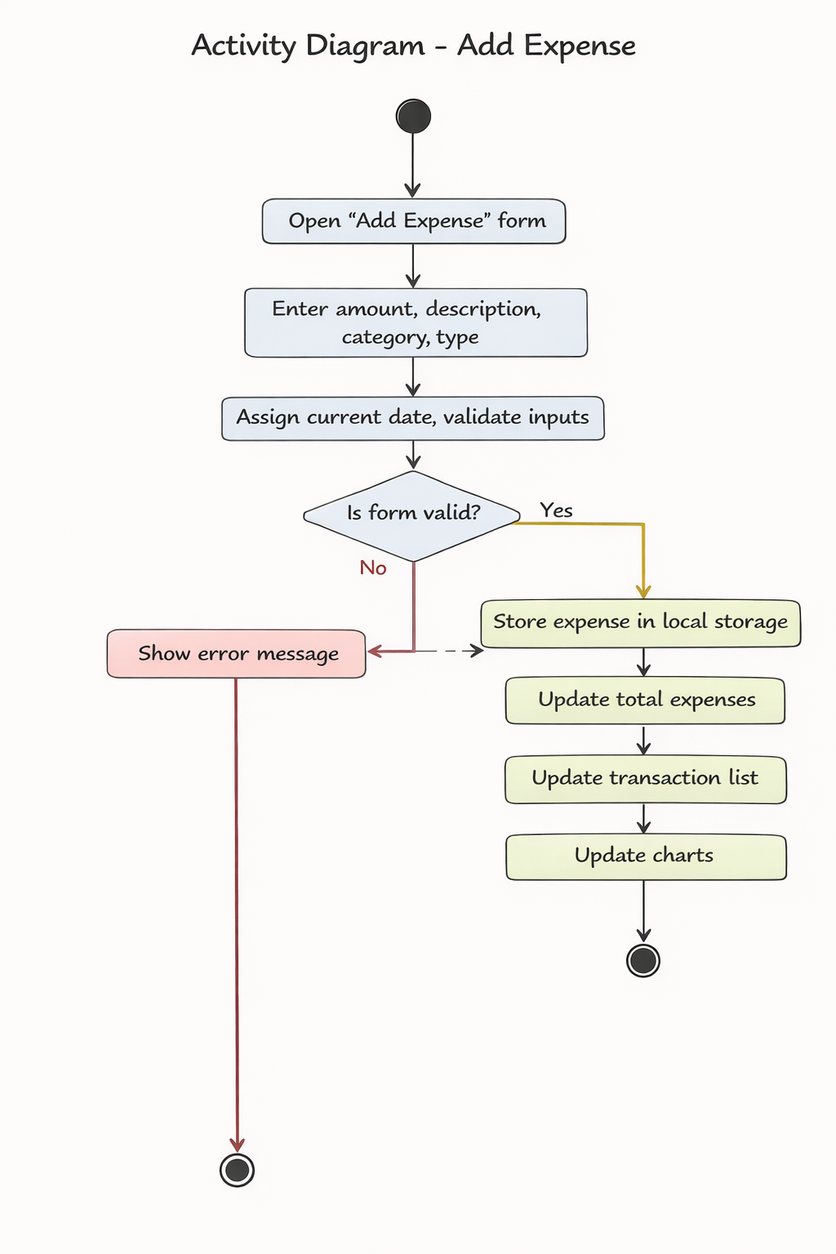
Activity diagram

Slide 10
Categories Used
Each transaction belongs to a category:
Food
Transport
Rent
Education
Entertainment
Others
This helps users see where their money is spent.

Slide 11
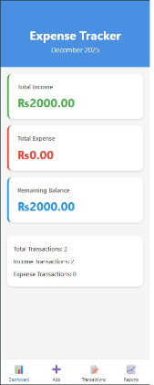
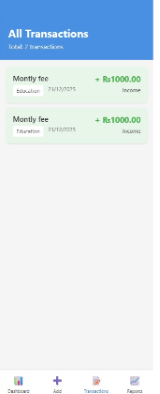
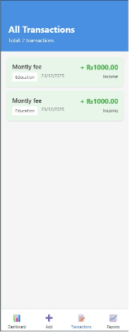
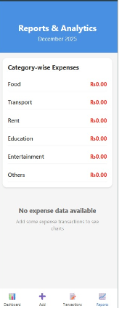
App Screens

Slide 12
Monthly Summary & Transaction List
Shows total income, expense, and balance
Displays all transactions using FlatList
Income is shown in green
Expense is shown in red
This gives a clear monthly financial view.

Slide 13
Charts & Reports
Bar Chart shows category-wise expenses
Pie Chart shows expense distribution
Charts update automatically when new
data is added, making analysis easy

Slide 14
Concepts Demonstrated
This project demonstrates:
useState & useEffect
AsyncStorage
FlatList: scrollable list of data
Form validation: it validate inputs
map, filter, reduce functions
These are core concepts of React Native.

Slide 15
Conclusion & Future Scope
This app is beginner-friendly, fully functional, and suitable for exams.
Future Enhancements:
Edit/Delete transactions
Budget limits
Dark mode
Export data
Notifications

